Slide 1
Understanding Auto Loans

Slide 2
Discussion
If you think of car commercials on TV, internet, or print, what are some of the special offers advertised?
What advice have you heard or been given about buying cars?

Slide 3
Before you get too excited about how much you can afford and start looking at the fanciest sports cars or most luxurious sedans, remember that your expenses will include not only your car payment, but also your insurance, gas, maintenance, and other miscellaneous costs associated with operating a vehicle. As a general rule, the more expensive the car, the more it costs to insure and maintain it.
Overview

Slide 4
Costs
What are the costs of owning a car?
What are the costs of operating a car?

Slide 5
Costs
Ownership Costs
Insurance
Service contract
Interest on loan
Registration fee, license, taxes, insurance, etc…
Depreciation
Operating Costs
Tires
Tickets
Gasoline
Parking and tolls
Oil and other fluids
Maintenance and repairs

Slide 6
DIFFERENT VEHICLES-DIFFERENT COSTS
COST | Subcompact | Compact | Mid-size | Minivan | Full-size
PER YEAR | $8400.48 | $8870.20 | $10 480.78 | $9 452.34 | $13 106.68
PER DAY | $23.01 | $24.30 | $28.71 | $25.89 | $35.91

Slide 7
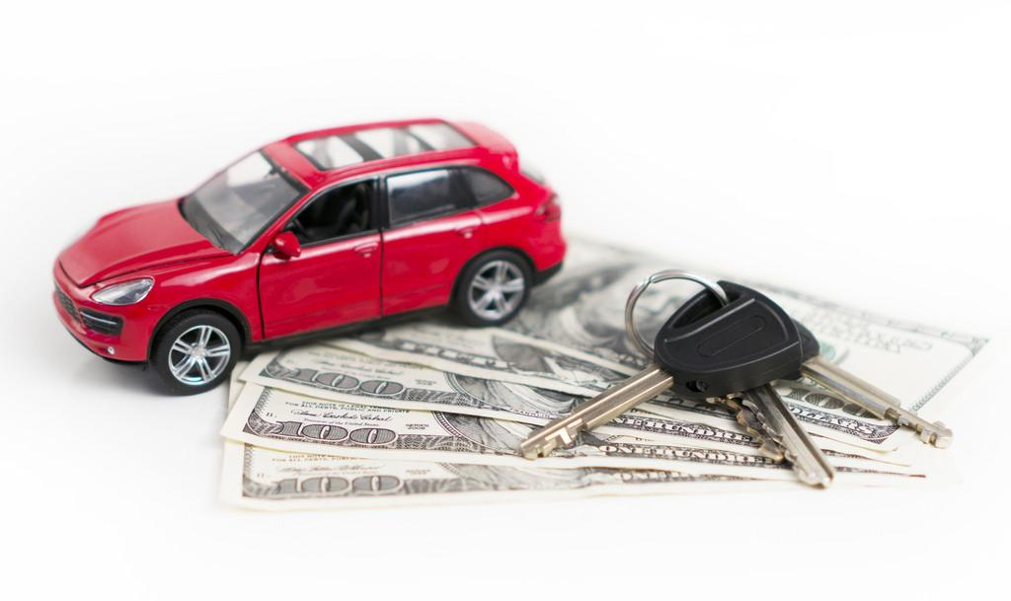
What are some factors that influence the selection of a vehicle?

Slide 8
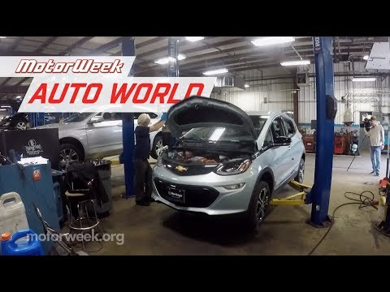
Electric Vs. Gas

Slide 9
How to Obtain a Vehicle Loan

Slide 10
Types of Credit
What is a Credit Score?
What is a Credit Score?
A three-digit number statistically representing your future creditworthiness based on the information in your credit report
Typically, good credit is 700 and above.
Bad credit is usually 550 and below.
300
Lowest
575
850
Highest*
* Highest score depends on organization issuing the credit score
www.nextgenpersonalfinance.org View all NGPF's lessons on Gooru

Slide 11
Paying Your Car Loan

Slide 12
Activity: Compare Auto Loans

